Slide 1
Binary Search Trees

Slide 2









Binary Search Trees
A type of table or dictionary (like Hash Table)‏
Store info in a node associated with a key
Each node can have up to two child nodes
one left child
one right child
Animation
4
1
6
5
7

Slide 3
Binary Search Trees
All left descendants have smaller key values
All right descendants have larger key values
Nodes w/o descendants are called leaf node
4
1
6
5
7

Slide 4
Binary Search Trees
1. To find a value in a tree start at the root
2. If the value is less than the current node look to its left child
3. If the value is greater, look to its right child
4
1
6
5
7

Slide 5
Binary Search Trees
1. To find a value in a tree start at the root
2. If the value is less than the current node look at its left child
3. If the value is greater, look at its right child
4. Repeat 2 until either we find the node or we reach the bottom of the tree
5. If we reach the bottom of the tree, it doesn’t contain the value

Slide 6
Binary Search Trees
TreeNode find(KeyType key, TreeNode t)‏
{
while ( t != null )
if ( key < t.key )‏
t = t.left;
else if ( key > t.key )‏
t = t.right;
else // found it!
return t;
return null;
}

Slide 7









Searching Tree
Search for 5
Start at root
4
1
6
5
7

Slide 8
Searching Tree
Since 5>4 look at right child
4
1
6
5
7

Slide 9








Searching Tree
Since 5<6 look at left child
4
1
6
5
7

Slide 10

Searching Tree
Found value!!!
4
1
6
5
7

Slide 11
Inserting a Node into a Tree
Find where to place node:
Use same algorithm as search algorithm
Two possible outcomes:
Find value is already in the tree
simply replace old value with new
End up at leaf node (it was not in tree):
If key is less than leaf node
add to left side
If key is greater than leaf node
add to right side

Slide 12
Removing a Node from the Tree
Three cases:
Leaf node
just remove node
Single child
replace with child node
Two children
swap key/value with adjacent value in an in-order traversal
it will have at most one child, so can (recursively) use previous two cases on it

Slide 13
In-order Traversal
A In-order traversal will visit all nodes in ascending sorted order
USE: sorting by keys
Algorithm for In-order Traversal:
Do In-order Traversal of left child
Process/Visit current node
Do In-order Traversal of right child
What order do you get if you swap 1 and 3?

Slide 14
Pre-order Traversal
A pre-order traversal will visit all nodes in prefix order
USE: allows rebuilding same tree
Algorithm for pre-order Traversal:
Process/Visit current node
Do In-order Traversal of left child
Do In-order Traversal of right child

Slide 15
Post-order Traversal
A post-order traversal will visit all nodes in postfix order
USE: deleting nodes of a tree
USE: evaluating expressions as trees
e.g., (3*5)-(4/2)
Algorithm for post-order Traversal:
Do In-order Traversal of left child
Do In-order Traversal of right child
Process/Visit current node

Slide 16
Tree-Minimum/Maximum
Minimum
while ( t->left != nullptr ) do
t = t->left;
return t;
Maximum
while ( t->right != nullptr ) do
t = t->right;
return t;
Time complexity: O(h) - h is height of tree

Slide 17
Time Complexity
Insert, find, remove are all the same
Depends on the height of the tree O(h)
but must be a function of N = keys in Table
If the tree is roughly balanced, h = O(log(N)‏)
If tree isn’t balanced, h = O(N)
Worst case is caused by inserting keys
in (nearly) ascending order or
in (nearly) descending order
Balanced trees can prevent this degeneration
Master Method for solving recurrence relations

Slide 18
Using Recursion
When is recursion appropriate?
T(N) = N*N ?
T(N) = N ?
T(N) = lg(N) ?

Slide 19

















Balancing Trees with Rotations
Can use order preserving rotations to keep tree balanced
AVL, WAVL, Red/Black CS Animated
y
Left rotation
x
x
y






Right rotation

Slide 20
AVL Trees
Adelson-Velskii and Landis
Stores height of each subtree
Strict Height Balanced (k=1) tree
Uses four cases for rotations
L/R single rotation
L/R double rotation
Guarantees O(lg N) operations
More complicated to implement
Link on Implementation

Slide 21
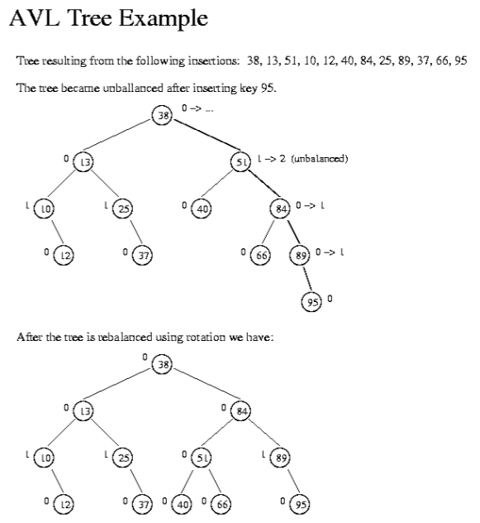
Example of AVL Tree

Slide 22
Problem 1
Write a function, copy, that takes one parameter, t, the root of a binary search tree and returns an identical copy of that tree. Assume the following definition for TreeNode.
class TreeNode
{
string key;
int info;
TreeNode * left, * right;
public:
TreeNode(string newKey, int newInfo, TreeNode *l, TreeNode *r)
{
// assigns parameter values to the appropriate data members
}
}

Slide 23
Problem Review
Write a function, reverse, that takes one string parameter and returns a new string that is the reverse of this string. You must do the reversal and not call some library function.

Slide 24
Problem 2
Write a function, mirror, that takes one parameter, t, the root of a binary search tree and converts this tree to a mirror tree of tree t. Assume the following definition for TreeNode.
Link
struct TreeNode
{
string key;
int info;
TreeNode * left, * right;
public:
TreeNode(string newKey, int newInfo, TreeNode *l, TreeNode *r)
{
// assigns parameter values to the appropriate data members
}
}

Slide 25
Problem 3
Write a function, isSubtree, that takes two parameter, t, the root of a larger binary search tree and s, the root of a smaller tree. It should return true only if s is isomorphic to a subtree of t. Ignore info.
class TreeNode
{
string key;
int info;
TreeNode * left, * right;
public:
TreeNode(string newKey, int newInfo, TreeNode *l, TreeNode *r)
{
// assigns parameter values to the appropriate data members
}
}

Slide 26
TreeNode Implementation
template <typename KeyType, typename ElementType>
class TreeNode
{
KeyType key;
ElementType info;
TreeNode * left, * right;
public:
TreeNode(KeyType newKey, ElementType newInfo,
TreeNode *l, TreeNode *r);
static TreeNode * newNode(KeyType k, ElementType e,
TreeNode * l, TreeNode * r) { return new TreeNode(k,e,l); }
static TreeNode * insert(KeyType key, ElementType info, TreeNode * t);
static TreeNode * find(KeyType key , TreeNode * t);
static TreeNode * remove(KeyType key , TreeNode * t);
static void print(ostream & out , TreeNode * t);
static void deleteNode(TreeNode * t) { delete t; }
static void deleteTree(TreeNode * t);
};

Slide 27
TreeNode::constructor
TreeNode(KeyType k, ElementType e,
TreeNode *l, TreeNode *r)‏
: key(k), info(e), left(l), right(r)‏
{
}
TreeNode * newNode(KeyType k, ElementType e,
TreeNode * l, TreeNode * r)‏
{
++nodesCreated;
return new TreeNode(k, e, l, r);
}

Slide 28
TreeNode::Insert
TreeNode * insert( KeyType key, InfoType info, TreeNode *RootT ) {
if ( !RootT ) RootT = newNode(key, info, nullptr, nullptr);
TreeNode * t = RootT;
while ( t->key != key )‏
if ( key < t->key )‏ {
if ( !t->left )‏
t->left = newNode(key, info, nullptr, nullptr);
t = t->left;
}
else if ( key > t->key )‏ {
if ( !t->right )‏
t->right = newNode(key, info, nullptr, nullptr);
t = t->right;
}
t->info = info;
return RootT;
}

Slide 29
TreeNode::find
TreeNode * find(KeyType key, TreeNode * t)‏
{
while ( t != nullptr )
if ( key < t->key )‏
t = t->left;
else if ( key > t->key )‏
t = t->right;
else // found it!
return t;
return nullptr;
}

Slide 30
TreeNode::remove
TreeNode * remove( KeyType key, TreeNode * t )‏
{
TreeNode * toRemove = find(key, t); // must do in-line
if ( toRemove->left == nullptr )‏
if ( toRemove->right == nullptr )‏
return nullptr;
else
return toRemove->right;
else if ( toRemove->right == nullptr )‏
return toRemove->left;
else { // hard case, two children
TreeNode * predecessorNode = findPred(key, toRemove);
swapKeyAndInfo(predecessorNode, toRemove);
toRemove = remove(key, toRemove);
return toRemove;
}
}

Slide 31
TreeNode::print
void print(ostream & out, TreeNode * t)‏
{
if ( t != nullptr )‏ {
out << ‘[‘;
print(out, t->left);
out << '(' << t->key << ',' << t->info << ')';
print(out, t->right);
out << ‘]‘;
} else
out << "nullptr";
}

Slide 32
TreeNode::deleteNode & deleteTree
static void deleteNode(TreeNode * t) { --nodesCreated; delete t; }
static void deleteTree(TreeNode * t)‏ { if ( t != nullptr )‏ { deleteTree(t->left); deleteTree(t->right); deleteNode(t); } }

Slide 33
Binary Search Tree Implementation
template
<typename KeyType,
typename ElementType>
class BinarySearchTree
{
TreeNode * root;
public:
void insert(KeyType key, ElementType info);
ElementType find(KeyType key);
void remove(KeyType key);
void print(ostream & out);
};

Slide 34
Binary Search Tree Implementation
void insert(KeyType key, ElementType info)‏
{
root = TreeNode::insert(key, info, root);
}
ElementType find(KeyType key)‏
{
TreeNode * t = TreeNode::find(key, root);
if ( !t ) {
insert(key, ElementType());
t = TreeNode::find(key, root);
}
return t->info;
}

Slide 35
Binary Search Tree Implementation
void remove(KeyType key)‏
{
root = TreeNode::remove(key, root);
}
void print(ostream & out)‏
{
TreeNode::print(out, root);
}

